Slide 1
Academic Affairs Workshop
The University Graduate School
September 18 and 22, 2014
http://graduate.indihhhhana.edu/pdf/achttp://
Jody Smith, Assistant Director of Academic Affairs
josmith@iu.edu, 855-4010

Slide 2
Presenters in order of initial presentations
September 18 and 22, 2014
David Daleke, Vice Provost for Graduate Education and Health Sciences; and
Associate Dean, The University Graduate School, daleked@iu.edu, 855-6902
Kim Bunch, Director Of Finance and Administration, kbunch@iu.edu, 855-1119
Jody Smith, Assistant Director of Academic Affairs, josmith@iu.edu, 855-4010
Yolanda Treviño, Assistant Dean, The University Graduate School, ytreviño@iu.edu, 855-8853
Kerchanin Allen, Temporary Fellowships Coordinator, 855-8852
Autumn Winfrey, Graduate Admissions and the Continuing Nondegree Program Coordinator, alwinfre@iu.edu, 856-4503
Maria Hamilton Abegunde, Director, The Graduate Mentoring Center, maehamil@iu.edu, 856-9379
Dana Harden, Master’s Recorder, druddick@iu.edu, 855-1117
Shelly Gerber-Sparks, Ph.D. Recorder, gerbers@iu.edu, 855-9345
Beth Nicodemus, Systems and Database Specialist, ejnic@iu.edu, 855-8854

Slide 3
Agenda
September 18 and 22, 2014
Welcome
(David Daleke)
Staffing
(Kim Bunch)
Bulletin, Curriculum, Degrees, and Graduate Faculty Status
(David Daleke, Jody Smith)
Recruitment, Financial Support, Admissions, and Student Support
Recruitment Efforts (Yolanda Treviño)
Financial Support (Kerchanin Allen)
GradGrants Center (Kim Bunch)
General Admissions Procedures (Kim Bunch and Autumn Winfrey)
Continuing Nondegree Program (Autumn Winfrey and Jody Smith)
CIC Traveling Scholar Program (Jody Smith)
Graduate Mentoring Center (Maria Hamilton Abegunde)
Recording and Degree Conferral
Masters Degree Requirements (Dana Harden)
Doctoral Degree Requirements (Shelly Gerber-Sparks)
eDoc Lites (Beth Nicodemus)

Slide 4
Welcome
Academic Affairs Workshop 2014
David Daleke
Vice Provost for Graduate Education and Health Sciences
Associate Dean, The University Graduate School

Slide 5
Key Activities
Facilitate approval of new graduate degrees, minors, and certificates;
Augment recruitment and retention, particularly in areas of special need such as diversity-building and STEM via fellowships and programming;
Assist academic units with program review;
Recording of graduate degrees and quality control of degree requirements;
Establish pipeline programs for transition from undergrad to graduate (e.g., McNair Program [funded by DOE], Tsinghua Summer Undergraduate Research Program, and IU Undergraduate Research Conference) and graduate to postdoc and the professoriate (e.g., Alliance for Graduate Education in the Professoriate [funded by NSF], IU Future Faculty Teaching Fellowship Program, and Preparing Future Professionals Program);
Advocate for the quality of graduate and professional student life by working with the Graduate and Professional Student Organization (IUB) and Graduate and Professional Student Government (IUPUI) on issues of graduate and professional student concern;
Operation of the GradGrants Center to assist graduate students with identifying and writing grant proposals;
Operation of the Graduate Mentoring Center to provide programming for IUB graduates and postdocs.
5

Slide 6
Challenges in Graduate Education
Lengthy time-to-degree and poor completion rate for the Ph.D.;
Availability of graduate student funding and increasing student debt burden;
Decreasing federal student support;
International competition for graduate students;
Lack of a diverse pipeline for graduate school, particularly in STEM fields; and,
Inadequate career preparation and knowledge of different career pathways, particularly for Ph.D. recipients.
6

Slide 7
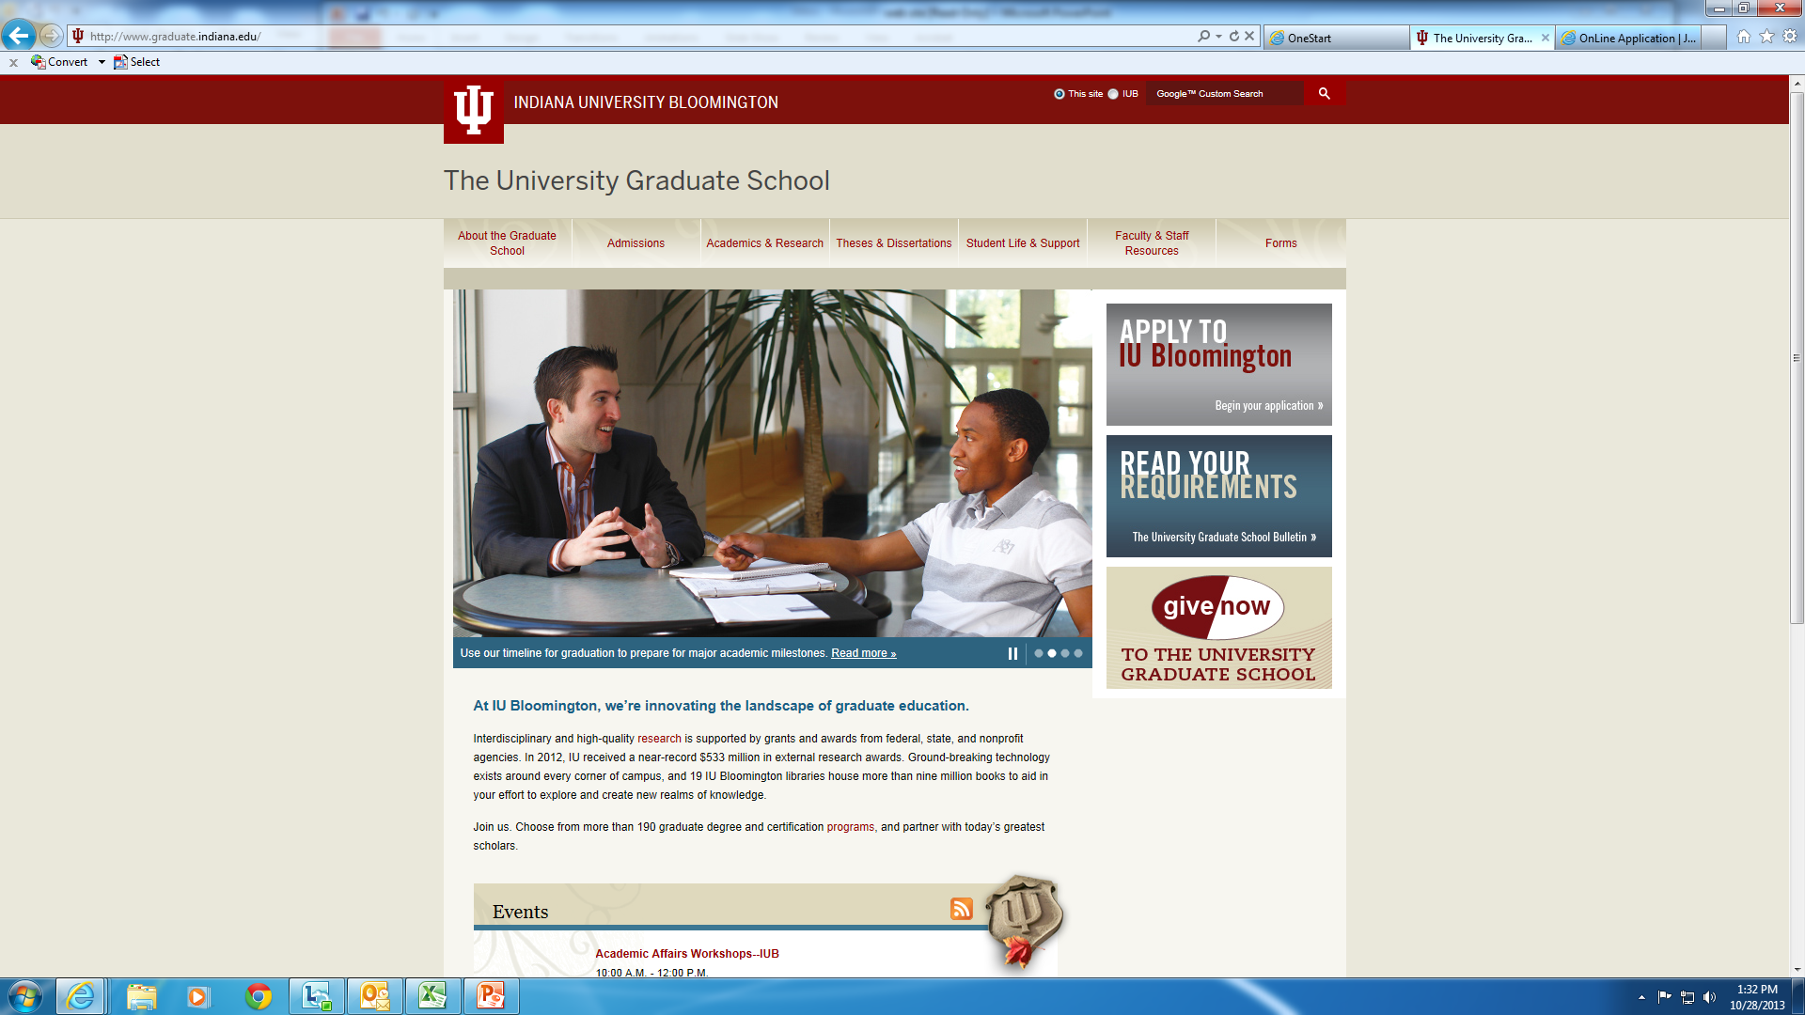
University Graduate School Web Site
September 18 and 22, 2014
http://graduate.indiana.edu

Slide 8
The University Graduate School - Bloomington
Staffing
Kim Bunch
Director of Finance and Administration

Slide 9
Staff
September 18 and 22, 2014
James Wimbush, Vice President, Diversity, Equity, and Multicultural Affairs; Dean, The University Graduate School (jwimbush@iu.edu)
David Daleke, Vice Provost for Graduate Education and Health Sciences; Associate
Dean, The University Graduate School (daleked@iu.edu)
Janice Blum, Associate Vice Chancellor for Graduate Education, IUPUI, and Associate
Dean, The University Graduate School (jblum@iupui.edu, 317-274-5845
Maria Hamilton Abegunde, Director, The Graduate Mentoring Center
(maehamil@iu.edu, 856-9379)
Jack Schmit, Assistant Dean, The University Graduate School (schmit@iu.edu,
855-9104)
Yolanda Treviño, Assistant Dean, The University Graduate School (ytreviño@iu.edu,
855-1594)
Kim Bunch, Director of Finance and Administration (kbunch@iu.edu, 855-1119)
Jody Smith, Assistant Director of Academic Affairs (josmith@iu.edu, 855-4010)
Nan Harvey, Database Analyst (nlharvey@iu.edu, 856-5226)

Slide 10
Staffing (continued)
September 18 and 22, 2014
Julia Jennings, Executive Administrative Assistant to the Dean (jenningj@iu.edu,
855-5697
Beth Nicodemus, Systems and Database Specialist (ejnic@iu.edu, 855-8854)
Jennifer Barron, Program Coordinator, McNair Scholars Program (jebarron@iu.edu, 855-4005)
Yvonne Dwigans and Kerchanin Allen, Graduate Fellowships and Awards Coordinator (ylivings@iu.edu and allenka@indiana.edu, 855-8852)
Shelley Gerber-Sparks, Ph.D. Recorder (gerbers@iu.edu, 855-9345)
Dana Harden, Master’s Recorder (druddick@iu.edu), 855-1117)
Autumn Winfrey, Graduate Admissions and the Continuing Nondegree Program
Coordinator (alwinfre@iu.edu, 856-4503)
Rebecca Winkle, Graduate Recruitment and Outreach Coordinator (rgconway@iu.edu, 855-4039)
Vacancy, Administrative Assistant to the Associate Dean (855-1362)

Slide 11
Academics
Bulletin, Curriculum, Degrees, and Graduate Faculty
David Daleke
Jody Smith

Slide 12
September 18 and 22, 2014
The University Graduate School Bulletin
Updated annually
Deadline for 2015-2016 updates will be February 1
Verification of every change submitted
Department must carefully proof each new bulletin
Two options, but online most correct

Slide 13
Curriculum Important Things to Know
September 18 and 22, 2014
The Graduate School requires syllabus information. You have two options for providing syllabus information via CARMIn:
Answer the “Essential Syllabus Information” questions (ESI 1-5)
Attach a syllabus to the course request
Complete #16 (Course Description) as that information will eventually be used by the WCMS system and automatically appear in the bulletin. Maximum of 50 words.
A learning assessment rubric is also required in #ESI-5 for accreditation purposes (i.e., A description of major course requirements and percentage breakdowns—for example: participation, 5%; three essays at 15% each; two exams at 25% each).
If a course carries both undergraduate and graduate credit, please explain how the expectations of quantity and quality of work will differ for undergraduate and graduate enrollees.

Slide 14
Curriculum Important Things to Know (Continued)
September 18 and 22, 2014
Course requests go on the 30-day University-wide remonstrance list that is administered by University Student Services and Systems (USSS)
A new remonstrance list is posted the first business day of each month
After the 30-day remonstrance period, the course form is routed to The University Graduate School and then USSS for final approvals
Please contact Mandy Bartley (bartley@iu.edu) if you are unfamiliar with CARMIn (the electronic course approval system), there are job aids available at the USSS training website (https://usss.iu.edu/Pages/CourseCatalog.aspx)

Slide 15
Degrees/Graduate Faculty
September 18 and 22, 2014
Degrees: Before a concentration, minor, graduate certificate, or degree can be conferred, its requirements must be in the University Graduate School’s Bulletin after having been approved by all required levels of administrative approval.
See the Matrix for Administrative Approval Process for New Programs at http://uapp.iu.edu/programs/docs/Academic%20Approval%20Matrix.pdf)
See how to propose new programs on our web site at http://graduate.indiana.edu/faculty-staff/membership.shtml
Graduate Faculty: All tenured or tenure-track faculty automatically hold Graduate Faculty status and can serve on research committees. To chair a committee, a Graduate Faculty member has to be nominated by their department to be endorsed to chair.
We request nominations twice a year.
Your faculty should be included in your Bulletin entry.
A list of Graduate Faculty and those endorsed can be found on our web site at Faculty & Staff Resources, http://graduate.indiana.edu/faculty-staff/membership.shtml

Slide 16
Broadening Participation
Recruitment, Retention, Advancement
resources to tap into …
Yolanda Treviño, Ph.D.
Assistant Dean

Slide 17
President’s Diversity Initiative
President Michael A. McRobbie’s commitment to expand funding demonstrates his belief that a place of higher learning and opportunity requires the presence of a supportive environment that nourishes, promotes, and fosters inclusion and diversity.
Recruitment Fellowships, Initiatives and Programs
President’s Graduate Diversity Recruitment Fellowship
Five years of support: 2 fellowship years + 3 graduate assistantship years
2. Increase the presence of IU faculty/ senior graduate students at URM recruiting venues and advertise programs widely; send faculty to MSIs to meet with URM faculty and students
Sustained membership in the National GEM Consortium
4. Expand GU2IU program to disciplinary areas (50 new visitors)

Slide 18
President’s Diversity Initiative
Mentoring and Community Building
Graduate Mentoring Center
Innovators and Trailblazers in URM graduate education seminar series
3. National Center for Faculty Development and Diversity
4. Emissaries for Graduate Student Diversity
Recruitment and Outreach Cohort
Retention and Community building Cohort
5. Compact for Diversity – Institute on Teaching and Mentoring
Doctoral Scholars Award (3 yrs)
Dissertation Award (1 yr)

Slide 19
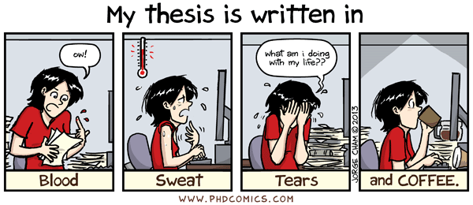
President’s Diversity Initiative
Timely Degree Completion
President’s Diversity Dissertation Fellowship

Slide 20
Recruitment Efforts
Summer 2014
Research Experiences for Undergraduates Programs
STEM Initiative / Summer Scholars Institute (IU and IUPUI)
Fall 2014
Emissaries for Graduate Student Diversity
CIC FreeApp Program
Project 1000
McNair Scholar Directory – September
Membership with The National GEM Consortium
Getting You into IU campus preview – October
California Diversity Forum – 1,000+ attendees
Institute for Broadening Participation – 7,000+ names
IU Undergraduate Research Conference – November
National Name Exchange – 8,600+ names

Slide 21
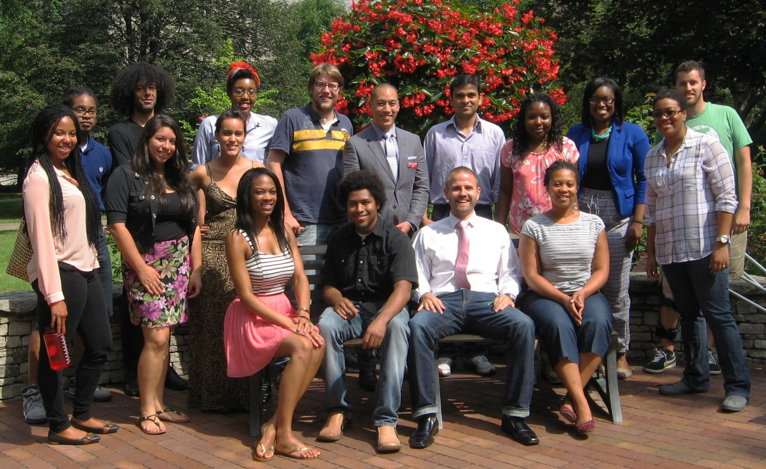
Emissaries for Graduate Student Diversity
to broaden the participation of underrepresented students; and, to build a more inclusive IU Bloomington graduate student community.
Notes:
Current graduate students serve as Emissaries for Graduate Student Diversity by sharing their experiences at Indiana University. Emissaries blog about life in Bloomington and are available to answer prospective students’ questions personally via e-mail.

Slide 22
Emissaries for Graduate Student Diversity
The University Graduate School Academic Affairs Workshop
Anthropology
Astronomy
Biology
Business Administration
Chemistry
Communication and Culture
Counseling and Educational Psychology
Educational Leadership and Policy Studies
Elementary Education
Higher Education
History
Kinesiology
Latin American Studies
Psychological and Brain Sciences (Mathematical Psychology)
Public Affairs
Sociology
Telecommunications
Notes:
Current graduate students serve as Emissaries for Graduate Student Diversity by sharing their experiences at Indiana University. Emissaries blog about life in Bloomington and are available to answer prospective students’ questions personally via e-mail.

Slide 23
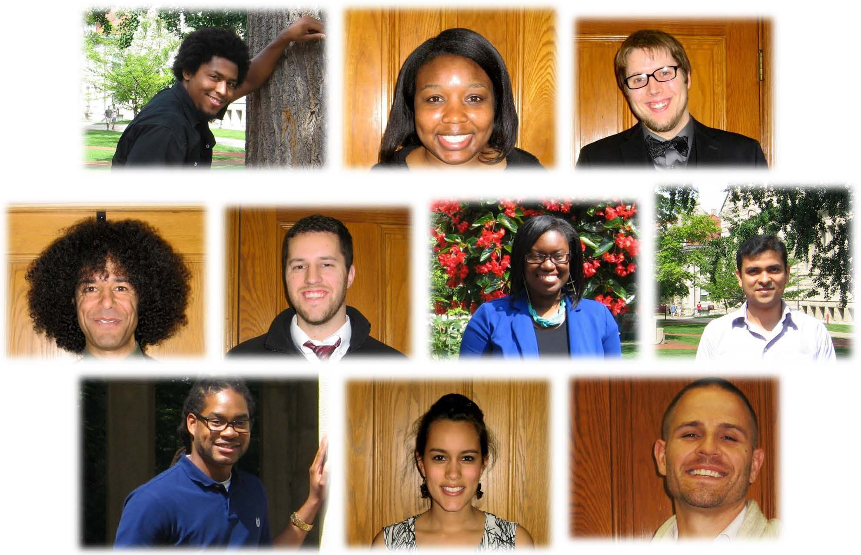
Emissaries for Graduate Student Diversity
The University Graduate School Academic Affairs Workshop
The primary role of Recruitment and Outreach emissaries is to serve as initial peer contacts for pre-application graduate and professional students. Using effective peer-to peer communication channels, emissaries will work to positively support the university’s recruitment, outreach and advocacy efforts across diverse communities.
Notes:
Current graduate students serve as Emissaries for Graduate Student Diversity by sharing their experiences at Indiana University. Emissaries blog about life in Bloomington and are available to answer prospective students’ questions personally via e-mail.

Slide 24
Blog: Graduate Student Life @ IU Wisdom from the Indiana University Emissaries for Graduate Student Diversity on the Bloomington campus http://www.indiana.edu/~gradlife/
ñ

Slide 25
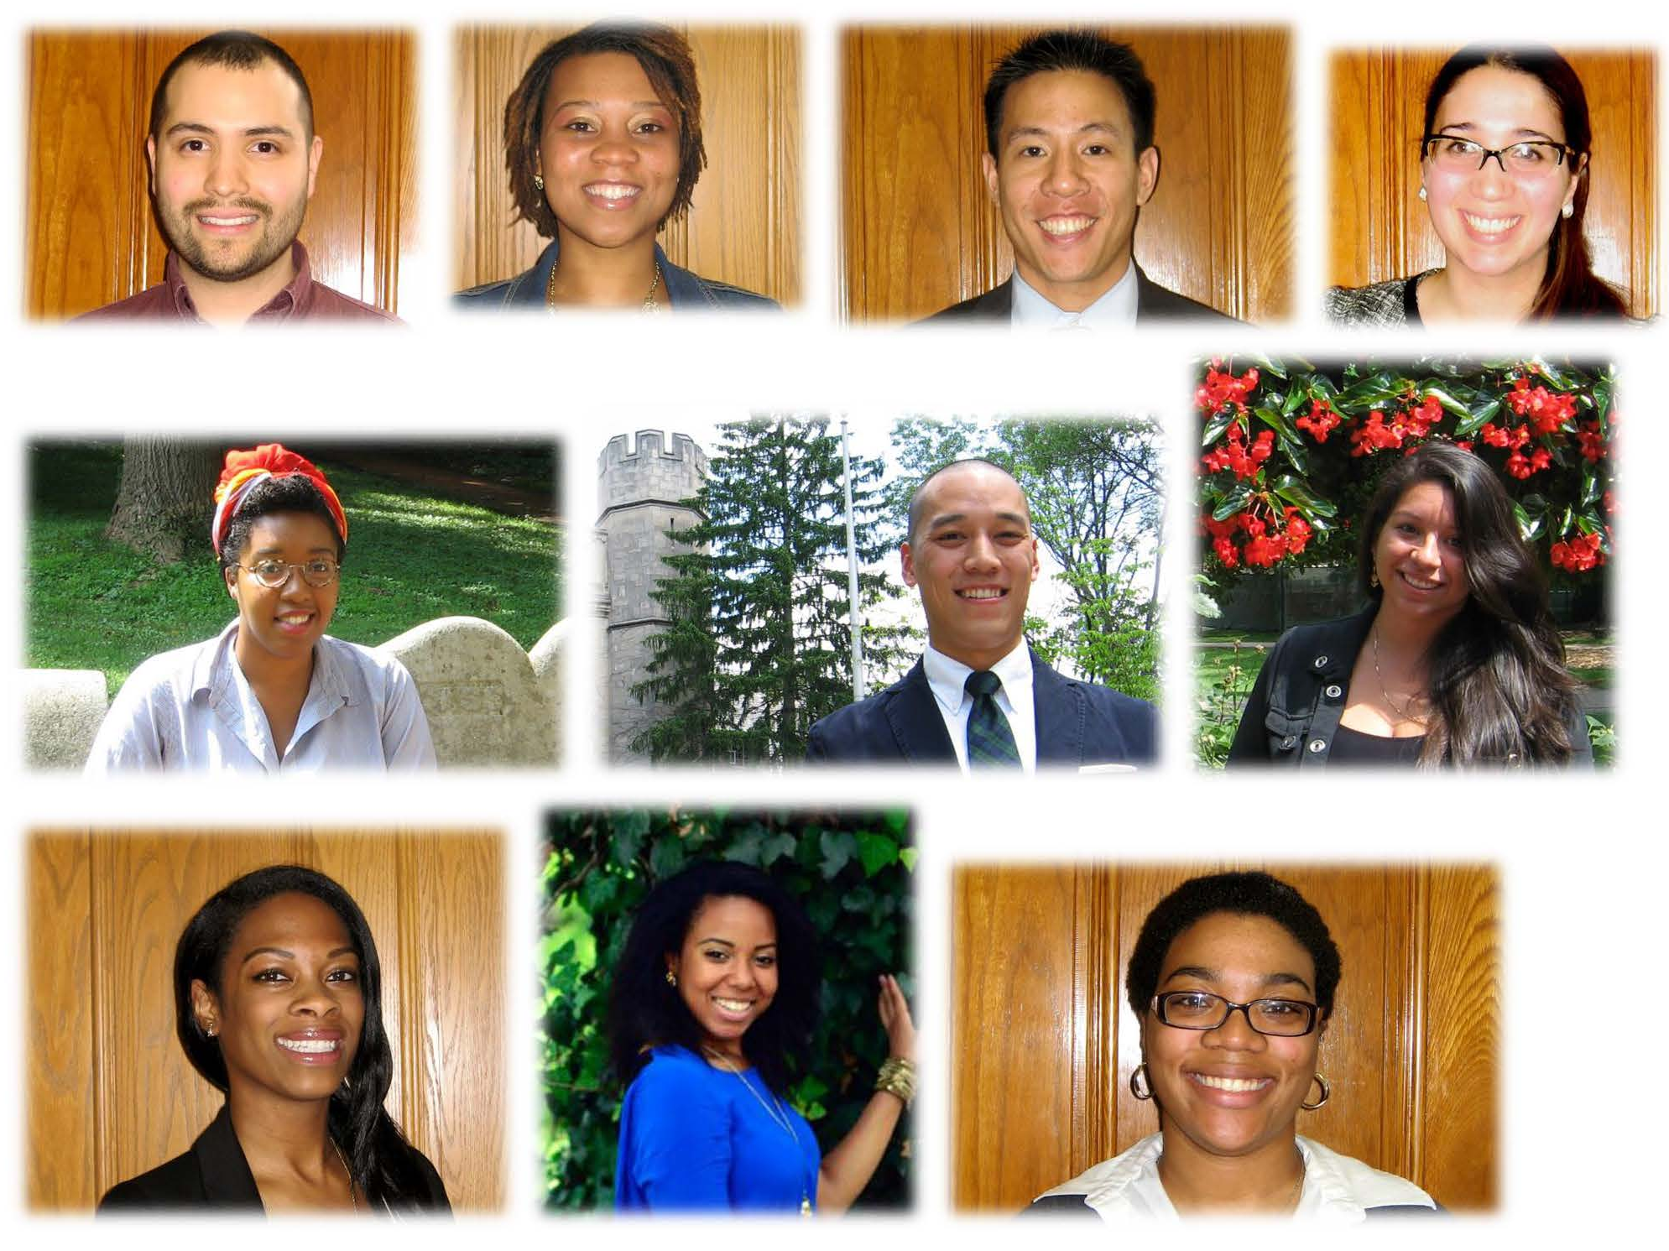
Emissaries for Graduate Student Diversity
The University Graduate School Academic Affairs Workshop
The primary role of Retention and Community Building emissaries is to build a more inclusive graduate student community through formal and informal mentoring activities, particularly for underrepresented and minority students. A major function of community-building emissaries is to provide for the interchange/exchange of information that facilitate progression and successful completion of their graduate student program.
Notes:
Current graduate students serve as Emissaries for Graduate Student Diversity by sharing their experiences at Indiana University. Emissaries blog about life in Bloomington and are available to answer prospective students’ questions personally via e-mail.

Slide 26
Recruitment Awards for 2015-16
President’s Graduate Recruitment Fellowship
Graduate Scholars Fellowship
Adam W. Herbert Graduate Fellowship
McNair Graduate Scholars Fellowship
Educational Opportunity Fellowship

Slide 27
Highlighted 2015-16 Eligibilities
Adam W. Herbert Graduate Fellowship
Supports graduate study at Indiana University for graduates of Historically Black Colleges and Universities (HBCUs) in STEM programs. PhD Fellowships are four (4)-year stipend awards of $25,000 per year. Masters fellowships are single year awards of $10,000.
President’s Graduate Recruitment Fellowship
Nominee must belong to an underrepresented minority group (African American, Hispanic American, Pacific Islander/Native Hawaiian or Native American, with tribal enrollment card or proof of descent); and applying to a PhD or MFA program. Fellowships are multi-year awards with two (2)-years of no assistantship duties and stipends of $20,000- 25,000 per year.
Graduate Scholars Fellowship
Nominee must belong to an underrepresented minority group (African American, Hispanic American, Pacific Islander/Native Hawaiian or Native American, with tribal enrollment card or proof of descent); and applying to a PhD or MFA program. Fellowships are multi-year awards with one (1)-year of no assistantship duties and stipends of $20,000- 25,000 per year.

Slide 28
Highlighted 2015-16 Eligibilities
Graduate McNair Scholars Fellowship
Nominee must provide documentation from their undergraduate McNair Scholars program certifying status as a McNair Scholar; and applying to a PhD or MFA program. Fellowships are multi-year awards with two (2)-years of no assistantship duties and stipends of $20,000- 25,000 per year.
Educational Opportunity Fellowship
Must be first generation college or low income. Award is one (1) year with a stipend of $1,500 and fee award that reduces tuition to the in-state rate for up to 24 credit hours.

Slide 29
Nomination Deadline for 2015-16 Award Competition
Friday, February 6, 2015
Notes:
Nominations should include the student’s complete application which includes all required attachments, and all recommendation letters.
Nominations should not be submitted before the student submits an application

Slide 30
Financial Support
Award and Fellowship Nomination Submission Procedures…
Yvonne Dwigans and Kerchanin Allen
Graduate Fellowships and Awards Coordinator

Slide 31
SharePoint Site
All fellowship nominations are submitted through the The University Graduate School SharePoint site.
For those of you not familiar with SharePoint, it is a cloud service for IU Faculty, grad students, and staff which allows document storage and sharing via the web using various online tools such as Word, Excel, PowerPoint, and OneNote. It is managed by the University, so your data is protected and compliant with University policy.

Slide 32
How to Submit a Nomination
Open the SharePoint site: https://www.sharepoint.iu.edu/sites/UGSAwardsAndFellowships/default.aspx
We suggest adding this site to your favorites

Slide 33
How to Submit a Nomination
2. Click the Award and Fellowship Nominations link under Libraries

Slide 34
How to Submit a Nomination
3. Click on your Department’s folder (you might only see yours)

Slide 35
How to Submit a Nomination
4. Click on the Add document link (if the add document button is not visible, click on the Upload Document in the banner)

Slide 36
How to Submit a Nomination
5. The upload document window pops up
Leave the “Overwrite …” checkbox checked
Click “OK” to save, this will bring up another window

Slide 37
How to Submit a Nomination
6. This window has a few questions you need to answer
Select the Award/Fellowship for which you are submitting the nomination
If you are submitting more than one nomination
Attach one nomination per file
Select the rank of the one you are attaching, one being the highest
Enter the student’s university ID number
Leave the Title field blank

Slide 38
How to Submit a Nomination
7. Click save
The window will go away and you will see your file has loaded to the site
If you have more nominations to submit, click the “Add document” link

Slide 39
Fellowship/Award Deadlines
Esther L. Kinsley Master’s Thesis Award Dept. deadline: Friday, Sept. 26, 2014
The Wells Graduate Fellowship Dept. deadline: Friday, Nov. 21, 2014
Grant-in-Aid of Doctoral Research Dept. deadline: Friday, Oct. 3, 2014 (fall) and Friday, Feb. 13, 2015 (spring)
Grant-in-Aid of Master’s of Fine Arts Projects Dept. deadline: Friday, Oct. 3, 2014 (fall) and Friday, Feb. 13, 2015 (spring)
Future Faculty Teaching Fellowship Student deadline: Friday, Oct. 10, 2014; Dept. deadline: Jan. 23, 2015
Esther L. Kinsley Ph.D. Dissertation Award Dept. deadline: Friday, Jan. 30, 2015
Ronald E. McNair Graduate Fellowship Dept. nomination deadline: Friday, Feb. 6, 2015
Graduate Women in Science Fellowship Dept. nomination deadline: Friday, Feb. 6,

Slide 40
Fellowship/Award Deadlines (cont’d)
Educational Opportunity Fellowship (EOF): Students submit applications to department to be eligible. Dept. nomination deadline: Friday, Feb. 6, 2015
Graduate Scholars Fellowship Dept. nomination deadline: Friday, Feb. 6, 2015
Adam W. Herbert Graduate Fellowship Dept. nomination deadline: Friday, Feb. 6, 2015
President’s Graduate Diversity Fellowship Dept. nomination deadline: Friday, Feb. 6, 2015
John H. Edwards Fellowship Dept. deadline: Friday, Feb. 13, 2015
Santosh Jain Endowed Memorial Scholarship Dept. deadline: Friday, March 20, 2015
Irving and Shirley Brand Graduate Fellowship Dept. deadline: Friday, April 24, 2015

Slide 41
Awards and Fellowships SharePoint Site
To be added or removed from the UGS Awards and Fellowships SharePoint site, requests must be sent by email to Ms. Yvonne Dwigans, ylivings@iu.edu or Ms. Kerchanin Allen, allenka@indiana.edu.
Requests must include your username and department.

Slide 42
Fellowship Details
Refer to the University Graduate School website, http://graduate.indiana.edu/admissions/financial-support/fellowships-awards/index.shtml, to access the:
Guidelines for the nomination material which is required for each fellowship.
What materials need to be included
The order in which material needs to be submitted per nomination PDF
And any other important information
Application PDFs which the student needs to submit
Please note: If a nomination is not submitted correctly, it will be removed from the SharePoint site, and you will have to upload it again.

Slide 43
GradGrants Center
Provide several workshops for new and current students regarding funding opportunities.
Can give departmental workshops
Available to assist students who are searching for external funding
Contact information:
website: www.iub.edu/~gradgrnt
email: gradgrnt@indiana.edu

Slide 44
Admissions
Kim Bunch
Autumn Winfrey

Slide 45
APPLICATION PROCESS
September 18 and 22, 2014
Applications are routed via OneStart using Kuali/edoc
Attach Admission Letter to the eDoc.
Attach an original final undergraduate transcript. Departments are required to keep the original FINAL undergraduate transcript. A copy can be sent to us as long as you have the original. Departments need to maintain the transcript.
An email will be going out soon regarding missing final undergraduate transcripts.
Admissions workshops are scheduled for October 13, 15
IUIE workshops are scheduled for October 20, 21, 22
If edocs are returned to you, please check the notes section for the reason it was returned. Please use the notes section to send us additional information.
Programs outside of The College should send materials directly to the Graduate Admissions Coordinator, Autumn Winfrey (alwinfre@iu.edu)
.

Slide 46
International Applications
September 18 and 22, 2014
Make sure all students are marked as BACH EQUIV in iStart before you approve the edoc, or it will be returned.
International Admissions will handle all updates in SIS, so make sure to copy them on any updates or not-comings.

Slide 47
GRE Scores and Application Fees
September 18 and 22, 2014
Check SIS for GRE scores as they are loaded there first. Paper copies are no longer sent to departments.
Domestic application fee is $55.
Contact Kim Bunch for application fee waivers.
The e-app now accepts e-checks in addition to credit/debit cards.

Slide 48
E-App or IUIE Training
September 18 and 22, 2014
For eApp or IUIE training, changes to the department approvers and user groups contact:
Kim Bunch, 855-1119, kbunch@iu.edu
Nan Harvey, 856-5226, nlharvey@iu.edu

Slide 49
Continuing Nondegree Program Answers to Common Questions
September 18 and 22, 2014
Bloomington Campus only
Contact information: nondegr@indiana.edu or Autumn Winfrey
Bloomington Office of International Services (OIS) processes all international applications
CND Program allows enrollment in graduate courses, undergraduate courses, or combination—graduate fees assessed for all
Financial aid is not available.
http://graduate.indiana.edu/admissions/non-degree.shtml

Slide 50
September 18 and 22, 2014
CIC Traveling Scholar Program
Enables doctoral-level students at any CIC university to take advantage of educational opportunities at any other CIC university without change in registration or increase in tuition.
University of Chicago
University of Illinois
Indiana University
University of Iowa
University of Maryland
University of Michigan
Michigan State University
University of Minnesota
University of Nebraska
Northwestern University
Ohio State University
Pennsylvania State University
Purdue University
Rutgers, State University of New Jersey
University of Wisconsin
Student completes online application at
http://www.cic.net/projects/shared-courses/traveling-scholar-program/introduction
Notes:
who determines whether the off-campus opportunity would enhance the student’s education ahttp://www.cic.net/projects/shared-courses/traveling-scholar-program/introductionnd verify opportunity not available at IU. and they agree that student is qualified to enroll. Accurate email addresses crucial; otherwise, application will not route.

Slide 51
Graduate Mentoring Center
Maria E. Hamilton Abegunde, Ph.D.
Postdoctoral Fellow
Director

Slide 52
Establishment
The Graduate Mentoring Center (GMC) has been established to provide support services for mentoring and community building under the President’s Diversity Funding Initiative.

Slide 53
Mission
Teach mentoring skills via classes, multi-tiered programming, and diverse partnerships with a focus on graduate students and postdoctoral fellows.
Create opportunities that lead to mentorship between diverse graduate students, postdoctoral fellows, faculty, and other professionals.
Develop a diverse cadre of graduate student and postdoctoral mentors who will, in turn, work with research-focused undergraduates.
Offer opportunities to share research on mentoring and other topics.
Serve as a resource of graduate mentoring programs at IU and its affiliates.

Slide 54
Benefits
Mentorship training for graduate students, postdoctoral fellows, and faculty.
Research opportunities between graduate students, postdoctoral fellows, and faculty.
Intensive mentorship opportunities for URM students with leaders from diverse fields.
Collaborations to deliver mentorship training, services, and programs.
Diverse cadre of mentors and mentees.
Centralized resources on mentorship training, services, and programs.

Slide 55
Programming (examples)
Speaker Series: Innovators and Trailblazers in Underrepresented Minority (URM) Graduate Education
Mentoring Classes
Brown Bags
Working Groups

Slide 56
Staff
Director
Graduate Assistants
Bloomington (2)
IUPUI (1)

Slide 57
Contact
Maria E. Hamilton Abegunde
maehamil@indiana.edu
812-856-9379
Kirkwood Hall 102

Slide 58
Master’s Degree Processing
Dana Harden

Slide 59
September 18 and 22, 2014
Frequently Asked Questions and Information
Thesis: Traditional and Electronic
Applications
Deadlines
Revalidation
Backdated Degrees

Slide 60
Traditional and Electronic
September 18 and 22, 2014
Traditional:
2 Copies required by UGS
100% cotton paper
Deadline: 27th of the month
Electronic: ProQuest
Deadline: 15th of the month (Initial Submission)
By the 27th of the month: Thesis corrections as determined by the Master’s Recorder
Same Guidelines for Both

Slide 61
What about the Application for Graduation?
September 18 and 22, 2014
eDoc System
Combines application and recommendation form into
one eDoc
eDocs are preferred over paper applications
Use Route Log to track the location and status of eDoc
Deadline: 15th of the month the student wishes to graduate
Time Frame on Paper Applications
Allow enough turnaround time for recommendation form to be sent, returned, and reviewed
Name to Appear in the Commencement Program
December Commencement - September 25th
May Commencement - February 25th

Slide 62
Deadlines?
September 18 and 22, 2014
To Have Degree Conferred:
15th of the Month (with the exceptions of May and December):
Initial Electronic Thesis Submission
Recommendation Form
27th of the Month (with the exceptions of May and December):
Corrected Thesis
Bound Thesis
Final Undergraduate Transcript
Signed Acceptance Page
Grade Changes

Slide 63
What About Revalidation?
September 18 and 22, 2014
All Courses Over 5-Year Limit
Must be individually revalidated
Must use Bulletin guidelines
6 Years for Dual Degrees
4-Step Process
List Course
Brief description of course
Method of revalidation
Brief explanation of how method was used to revalidate course

Slide 64
How Does a Backdated Degree Request Work?
September 18 and 22, 2014
Reason For Backdating
Must be administrative error
Cannot be student’s fault or because they forgot to turn in application to graduate
Approval Required by:
Department, UGS, and Registrar
Memo should be addressed to Dean Daleke and sent to me

Slide 65
Doctoral Degree Processing
Shelly Gerber-Sparks

Slide 66
PhD Milestones Tracked by the UGS
Nomination to Candidacy
Nomination of Research Committee
Defense Announcement
Submission of dissertation
Completion of all final degree requirements

Slide 67
Most Frequent Questions
Tracking edocs and verifying accuracy of information
Please track the progress of each edoc to make sure it reaches the UGS and review all edoc information for accuracy prior to approving
Revalidations
Requesting substitutions or waivers of requirements
Should be requested and approved by UGS prior to taking any substitute course or immediately after the department determines the student is eligible for a waiver
Process changed – send to recorder for processing now
Individualized minors
Should be requested and approved by UGS prior to taking any of the courses that make up the requested individualized minor
Research Committee Membership
Who and how many?

Slide 68
Research Committee Membership Requirements
All Research Committees:
Must have 4 current IU Members
All 4 must be listed on the Graduate Faculty or Emeritus Lists
Two (2) members, including the Chair, must have the Graduate Faculty endorsement
You can check the status of members on the Graduate Faculty and Emeritus lists on the University Graduate Schools website,
http://graduate.indiana.edu/faculty-staff/membership.shtml
Members from outside the University may serve on a committee, but they are in addition to the 4 IU members.
Students with outside members should attach the outside members’ CV to the Nomination of Research Committee e-doc prior to submitting it

Slide 69
If the Research Committee membership changes
Changes to the membership of a research committee are requested by submitting a Change of Research Committee e-doc
Any change must adhere to UGS committee requirements
Any change in committee membership should be reported right away but a change of research e-doc can be submitted right before the student’s defense if needed.

Slide 70
Important To Note: Changes and Reminders
Deadlines changed for PhD Commencement Participation Application
September 25th for December ceremony
February 25th for May Ceremony
Confirm month of graduation on Commencement app is correct – impacts future registration
All R, NR, or I grades need changed to a letter grade before a degree can be awarded
Signatures on the abstract and acceptance pages must be original – no proxy, electronic, photocopied, or scanned signatures are permitted
G901 summer registration
Who is eligible and how is it approved?

Slide 71
G901
G901 is only possible during a summer term when a student will complete their degree in that summer term and has a least one semester of G901 enrollment eligibility remaining.
The student must have either already defended or have a defense date set within the summer term and have stated their intention to complete within the term.
The student must have not taken more than five semesters of G901 prior to the summer enrollment
To request summer G901 registration, send an email to the PhD recorder (Shelly Gerber-Sparks) with the following information:
Student’s Name & IU ID#
Date of defense
How many G901 terms the student has enrolled in to date
Each summer G901 registration request is approved by Dean Daleke on a case-by-case basis

Slide 72
Recorders’ Q & A Sessions
Started in Summer 2014, the focus of the Recorders’ Q & A Sessions is to provide department staff with ongoing training and opportunities to ask questions in a small group setting.
Next scheduled Q&A Sessions are:
Wednesday, October 15, 2014
Wednesday, February 11, 2015
in the Kirkwood Hall UGS Conference Room
from 10 a.m. to 12 p.m.
RSVP via email at least one week in advance – gerbers@iu.edu

Slide 73
eDocs
Beth Nicodemus

Slide 74
eDoc Lite
The University Graduate School Academic Affairs Workshop
A system to replace paper forms that route to various people for approval
The eDocs are set-up with a structured route path that each eDoc follows
The University Graduate School forms route based on the department, or departments, the student has selected on the form
Each department has designated one or more people who should approve the documents

Slide 75
eDoc Lite (continued)
Benefits
More efficient for the student to complete
Approval process is more efficient
Easy to track

Slide 76
eDoc Lites Managed by UGS
The University Graduate School Academic Affairs Workshop
Currently available
Master’s Application and Recommendation for Advanced Degree
Ph.D. Commencement Participation Application
Defense Announcement
Nomination of Research Committee and Change of Research Committee
Nomination to Candidacy

Slide 77
Nomination of Research Committee
Student fills out most of the form, including the Research Committee member information
It routes to Department’s staff, who:
Enters the date the candidacy was approved
Verifies that at least two members of the committee are endorsed (including the chair)
Approves any members that are in the section for outside members

Slide 78
Nomination of Research Committee, (continued)
Then it routes to the Research Committee
All members receive the document for approval at the same time
It can be approved by them in any order
After the Committee has approved the document, you have the option to have the document route back to a person in the department, or directly to the University Graduate School.
When Shelly Gerbers-Sparks gives the Nomination her official University Graduate School approval, she will enter that date in the “For University Graduate School Use Only” section

Slide 79
Change of Research Committee
This form is similar to the Nomination of Research Committee
The student is only required to provide information that pertains to the change
Routes in a similar manner
If a committee member is being added, the student is required to enter the new member’s information and the document will route to them for approval
If they are not adding members, then the document is not required to route to any committee members

Slide 80
Nomination to Candidacy
Student fills out most of the form, including the Minor representative(s) and Advisory Committee Members
It routes to Department’s staff, who:
Enters the admit term
Qualifying exam dates
Additional Requirements
Confirms the minor rep and Advisory Committee members are correct
Attaches the course list and indicates revalidation or substitutions

Slide 81
Nomination to Candidacy (continued)
Advisory Committee Approves
Minor Representative approves and provides outside minor exam requirement information
Department Chair / Graduate Advisor approves
If needed, this can be set up at the ‘major’ level
Graduate School reviews and provides final approval

Slide 82
Tips for Finding Submitted eDocs
You may want to check the status of a student’s eDoc, or see who has it in their action list; to do this, you will need to do a document search. There are a couple of ways this can be done.
Search by the document ID number
Search by the student’s network ID

Slide 83
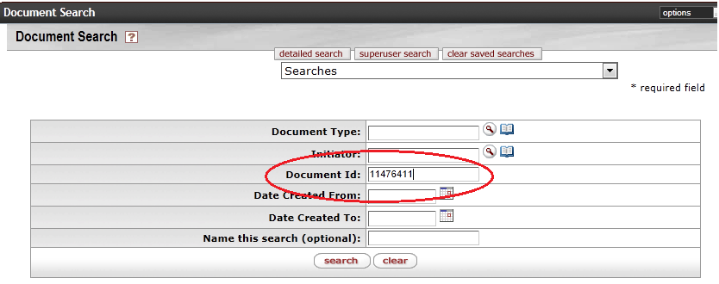
Searching by Document ID
This is the easiest method of searching
OneStart >> Notifications >> Document Search

Slide 84
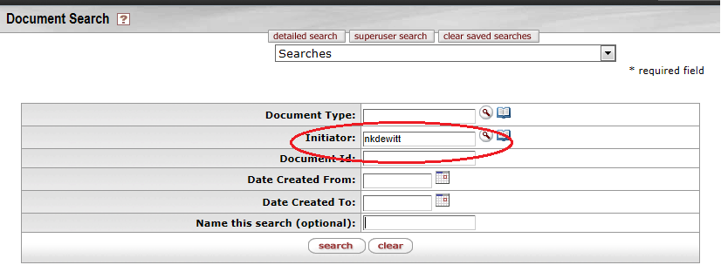
Searching by Student Network ID
You can search by the student’s network ID. If you do this, it will pull up ALL eDocs the student has submitted, so you could get a pretty long list.
OneStart >> Notifications >> Document Search

Slide 85
Checking the Status of an eDoc
Once you have the search results, you will want to either open the document or view the route log.
Click the document id to view the document
Click the Route Log icon to view the approval history of the document

Slide 86
Checking the Status of an eDoc (continued)
The route log will tell you several things:
Status: enroute, final, disapproved, saved
Who currently needs to approve
Approval history
Who has already approved the document
Whether it was returned to a previous approver
Did it take someone a long time to approve
Other out of the ordinary activity

Slide 87
Checking the Status of an eDoc (continued)

Slide 88
Thank you! From the staff of The University Graduate School - Bloomington Office
September 18 and 22, 2014

